Slide 1
Face Recognition
A tutorial

Slide 2
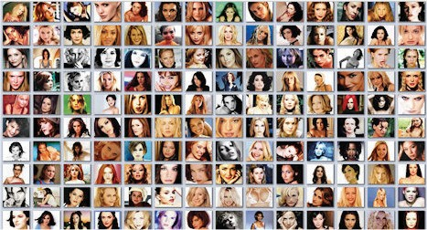
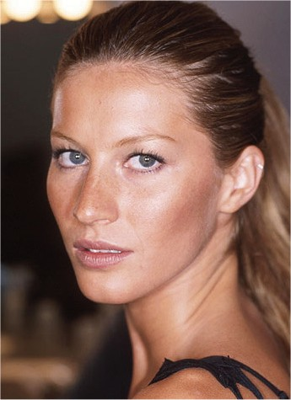
Face recognition problem
Given a still image or video of a scene, identify or verify one or more persons in this scene using a stored database of facial images
Who is she?
http://picasa.google.com

Slide 3


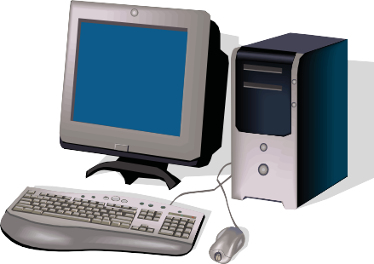
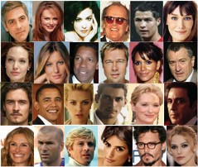
Face recognition/identification
Who is this person?
He is David.

Slide 4
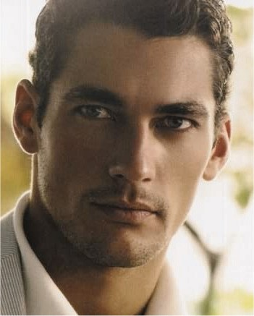
Face authentication/verification
Is he who he claims to be?
Yes, he is.
I am David.

Slide 5
Applications
Civil applications and law enforcement
National ID, passport, driver’s license, border control
Surveillance of public places (airports, metro stations, etc)
Forensic applications
Security applications for electronic transactions and access control
Physical access
Secure access to networks and infrastructures
e-health, e-commerce, e-banking (and now mobile…)
Ambient Intelligence
Smart homes
Natural human-machine interaction
Wearable systems
Memory aids and context-aware systems
Entertainment
Interactive movies, computer games
Search
Picasa 3.5 face recognition application for finding and managing photos

Slide 6
Face recognition in humans
The human visual system starts with a preference for face-like patterns
The human visual system devotes special neural mechanisms for face perception
Facial identity and expression might be processed separately
Facial features are processed holistically
Among facial features eyebrows are most important for recognition!
Humans can recognize faces in very low dimensional images
Tolerance to image degradation increases with familiarity
Color and texture are as important as shape
Illumination changes influence generalization
View-generalization is mediated by temporal association
P. Sinha, B. Balas, Y. Ostrovsky and R. Russell, “Face recognition by humans: 19 results all computer vision researchers should know about”, Proceedings of IEEE, 2006.

Slide 7
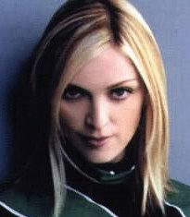


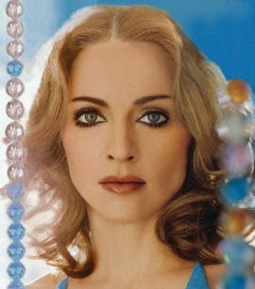
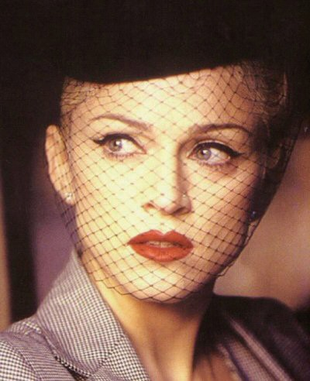
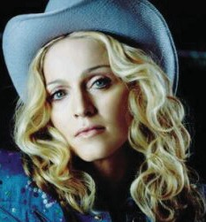


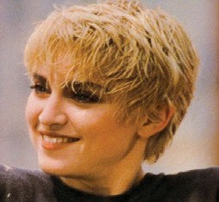
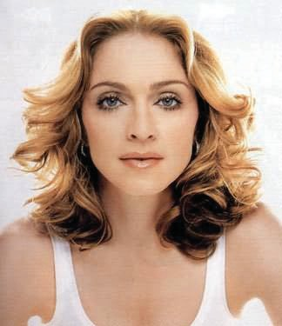
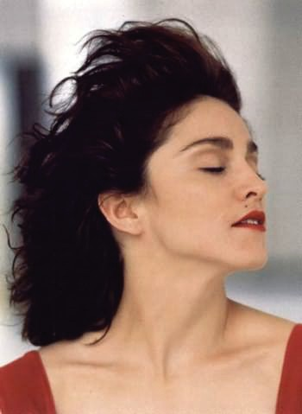
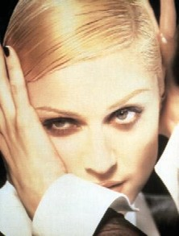
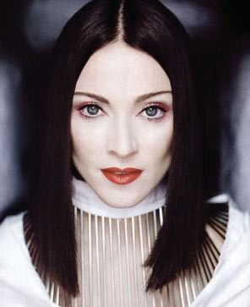

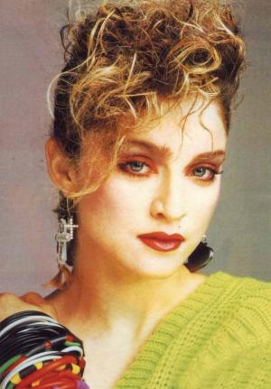
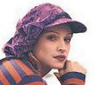
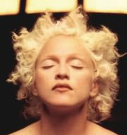

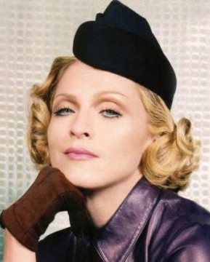


Challenges: Intrapersonal variations
If people can do it so easily, why can’t computers?
Intrapersonal (intra-class) variations are variations of the appearance of the same face caused by
Illumination variations
Pose variations
Facial expressions
Use of cosmetics and accessories, hairstyle changes
Temporal variations (aging, etc)

Slide 8
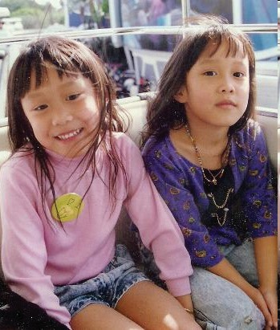
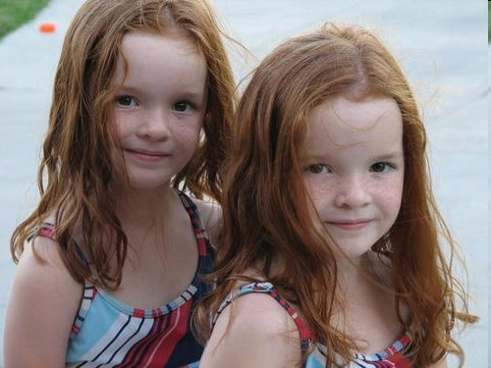
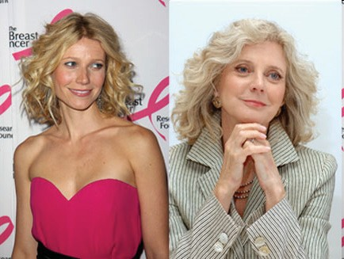
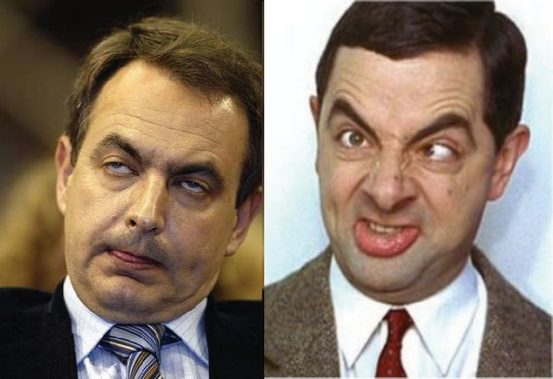
Challenges: Interclass similarity
Interclass similarity: different persons may have very similar appearance
Twins
Relatives
Strangers may look alike
http://multiples.about.com
http://www.nypost.com
http:// www.tujefetevigila.com

Slide 9
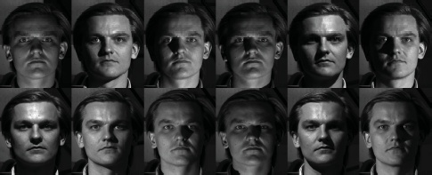
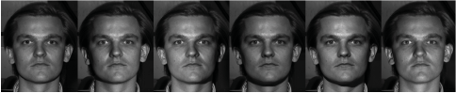
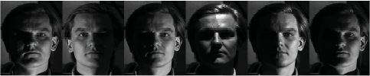
Challenges: Illumination variations
Illumination variations may significantly affect the appearance of a face in 2D images
Recognition performance may drop more than 40% for images taken outdoors!
Humans have difficulties in recognizing familiar faces when light direction changes (e.g. top-lit → bottom-lit)
Yale Face Database B
Yale Face Database B http://vision.ucsd.edu/~leekc/ExtYaleDatabase/ExtYaleB.html

Slide 10
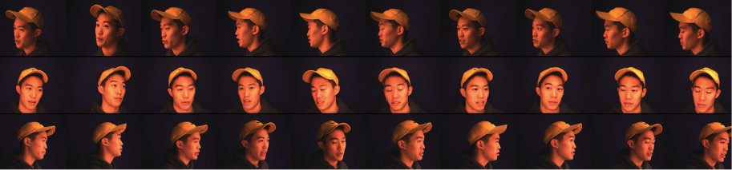
Challenges: Pose variations
Difference between two images of the same subject under different view angles is greater than differences between images of two different subjects under the same view
CMU Face In Action (FIA) Database
Rodney Goh, Lihao Liu, Xiaoming Liu and Tsuhan Chen, “The CMU Face In Action (FIA) Database”, Proc. Int. Workshop on Analysis and Modelling of Faces and Gesture, 2003.

Slide 11
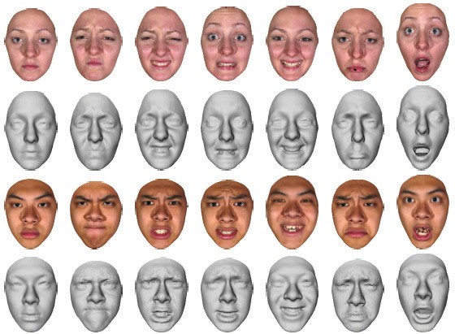
Challenges: Facial expressions
Facial expressions caused by facial muscle movements may significantly deform the face surface
Binghamton University 3D Facial Expression database
BU-3DFE (Binghamton University 3D Facial Expression) database http://www.cs.binghamton.edu/~lijun/Research/3DFE/3DFE_Analysis.html

Slide 12
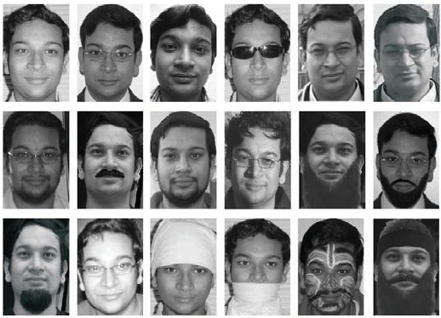
Challenges: Disguises
People may disguise to avoid being recognized…
R. Singh, M. Vatsa and A. Noore, “Recognizing Face Images with Disguise Variations”, Recent Advances in Face Recognition, I-Tech, Vienna, 2008.

Slide 13
Challenges: Information redundancy
20x20 facial image
256⁴⁰⁰=2³²⁰⁰ possible combinations of intensity values
Total world population as of 8 Oct. 2009 6,789,000,000 ≈ 2³²
That’s an extremely high-dimensional space…
Ming-Hsuan Yang, “Recent Advances in Face Detection: A tutorial”, Proc. Int. Conf. on Pattern Recognition, 2004.

Slide 14

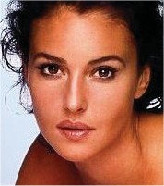


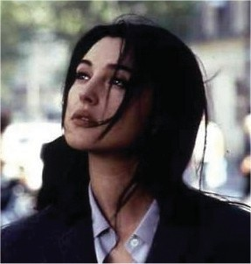
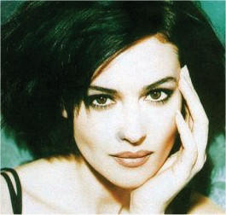

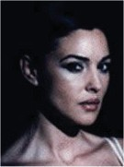

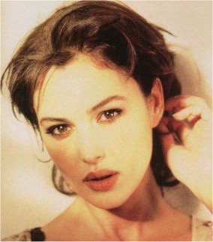
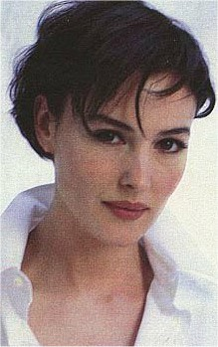
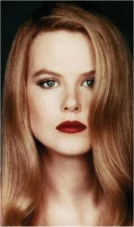
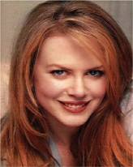


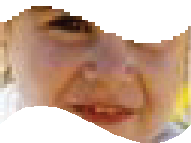

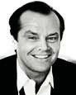


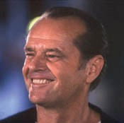
Typical face recognition system architecture
Face recognition/authentication
Image recording
Face detection
Feature detection (eyes, nose, etc)
Face normalization
Facial signature extraction
Face
detection
Feature detection
(eyes, nose, etc)
Face
normalization
Facial signature
extraction
I am MB.
S
Face authentication Is it MB?
S
Face recognition Who is it?
Face
authentication
Is it MB?
Yes, she is
S
1
Face
recognition
Who is it?
It is MB
S₃
S₂
S_{n}
User enrolment
Image recording
Face database (stored facial signatures)
Image
recording
S₁, S₂, …,S_{n}
Face normalization
Classifier training (Facial signature extraction)
Training set
Face
normalization
Classifier training
(Facial signature extraction)

Slide 15
Face detection

Slide 16
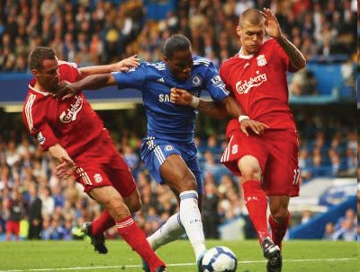


Face detection
Face detection: find all faces in an image (if any) regardless of their position, scale, in plane rotation, pose, illumination, facial expressions, occlusions
First step to every face recognition system
Face localization: find the exact location of a detected face
Detection of salient facial features such as eyes, nose, nostrils, eyebrows, mouth, etc
Face tracking: detect (“follow”) a face in a video sequence
M. M.-H. Yang, D. J. Kriegman, and N. Ahuja, “Detecting Faces in Images: A Survey”, IEEE Trans. on Pattern Analysis and Machine Intelligence, 2002

Slide 17
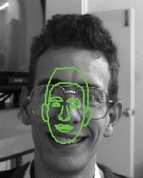
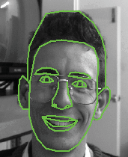
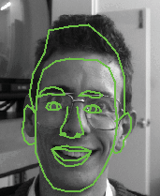
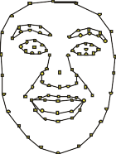
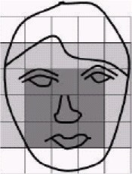
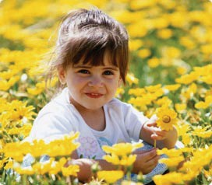
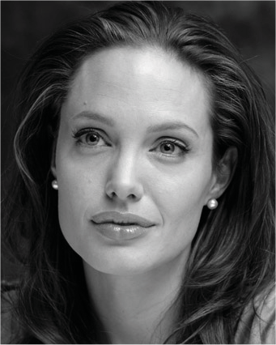



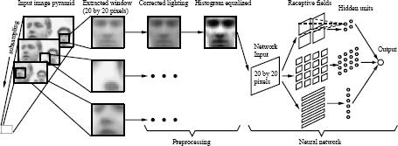
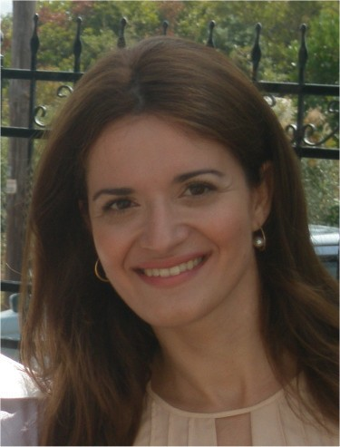
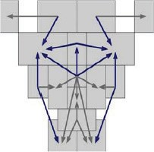


Face detection techniques
Knowledge-based
Translate knowledge about typical face to a set of rules
Structural matching
Statistical models of shape appearance based on a set of landmarks
© http://personalpages.manchester.ac.uk/staff/timothy.f.cootes/
Appearance-based
Learn face characteristics from a representative set of example images using classic machine learning techniques
Feature invariant
Find features of the face invariant to appearance variations (facial features, edges, shape, texture, skin color)
Template matching
Standard patterns stored to describing the face or facial features
Eigenfaces, Neural Networks, Distribution- based, HMM, Haar features
M. M.-H. Yang, D. J. Kriegman, and N. Ahuja, “Detecting Faces in Images: A Survey”, IEEE Trans. on Pattern Analysis and Machine Intelligence, 2002.
M. H. Yang, “Recent Advances in Face Detection: A tutorial”, Proc. Int. Conf. on Pattern Recognition, 2004.

Slide 18




Knowledge-based face detection
Define a set of rules to represent the face and use them for detection, e.g.
“Center face part has uniform intensity”
“Face has two eyes, a nose and a mouth”
Hierarchical approach examining the face at different resolution levels
Lower level: find possible face candidates based on image intensity
Mid level: detect edges
Higher level: extract facial features (mouth, eyes). Classify the image region as face or non-face
Not easy to translate knowledge into rules or extend rules to different poses
G. Yang and T. Huang, “Human face detection in a complex background”, Pattern Recognition, 1994.
M. H. Yang, “Recent Advances in Face Detection: A tutorial”, Proc. Int. Conf. on Pattern Recognition, 2004.

Slide 19





Feature invariant face detection
Extraction of local facial features (eyes, eyebrows, nose, mouth) using multi-resolution or derivative filters, edge detectors, morphological operations, etc
Statistical models, neural networks and graph matching used to describe relationships between features
Improved invariance under pose or illumination, problems due to occlusions, noise, complex background, etc

Slide 20



Skin color based face detection
Each pixel labeled as skin or non-skin
Connected component analysis and grouping to merge neighbor skin areas
A candidate region is classified as face if it satisfies some criteria
Easy to implement, insensitive to pose and facial expressions, but sensitive to illumination variations and other body-parts or skin-color like regions
J. Kovac, P. Peer and F. Solina, “Human Skin Colour Clustering for Face Detection”, Proc. Int. Conf. on Computer as a Tool, 2003.

Slide 21
Template based face detection
Several standard templates stored to describe the face as a whole or the facial features separately
Predefined templates based on edges, silhouettes
Deformable templates based on facial contours (e.g. Snakes)
Face detection based on correlation with these templates
Simple to implement but cannot deal with pose variations
M. H. Yang, “Recent Advances in Face Detection: A tutorial”, Proc. Int. Conf. on Pattern Recognition, 2004.
B. Scassellati, “Eye finding via face detection for a foevated, active vision system”, Proc. National Conf. on Artificial Intelligence, 1998.

Slide 22











Appearance based face detection
Uses statistical analysis and machine learning techniques to learn the “characteristics” of a face from a large set of images
PCA, LDA
Support Vector Machines
Neural Networks
Hidden Markov Models
Adaboost
Most successful approach, fast and robust
Detection rates 80-90% at a false positive rate of 10%
Needs to search over scale and space and requires large set of training examples
http://picasa.google.com

Slide 23

Eigenfaces for detection
A low-dimensional subspace (face space) is built using a large set of training images and Principal Component Analysis (PCA)
The distance of an image sub-window from the face space (DFFS) determines its likelihood to represent a face
Sensitive to pose variations
© W Fashion Magazine August 2002
B. Moghaddam and A. Pentland, “Probabilistic visual learning for object detection”, Int. Conf. on Computer Vision, 1995

Slide 24
Facial feature detection
Edge based techniques
Feature templates for eyes, mouth, nose
Problematic when features are occluded or obscured
Eigenfeatures
Eigeneyes, eigenmouth, etc
Gabor wavelets, multidimensional erotion- dilation
Structural matching using ASM, AAM, etc
More robust under shape or image intensity variation

Slide 25
2D face recognition techniques

Slide 26







2D face recognition techniques
Appearance-based (Holistic)
Eigenfaces, Fisherfaces, ICA, Kernel PCA, Local Feature Analysis (LFA), Hidden Markov Models (HMM)
Model-based
Active Appearance Models 3D morphable models
©National Geographic
Feature matching
Geometry methods Elastic Graph Matching
Neural networks
W. Zhao, R. Chellappa, A. Rosenfeld, and P. J. Phillips, “Face recognition: a literature survey,” ACM Computing Surveys, 2003.

Slide 27





Eigenfaces
Principal Component Analysis (PCA) applied on a set of images to extract a lower dimension subspace that best describes the variance of underlying data
Dimensionality reduction!
The principal components are called eigenfaces due to their face-like appearance
A face can be modeled as a linear combination of a small subset of the eigenfaces
Face recognition is based on comparing the coefficients of this linear representation
Easy to implement, but sensitive to pose, needs accurate alignment of probe and gallery
= α₁·
+ α₂·
+ α₃ ·
+ α₄ ·
M. Turk, and A. Pentland, “Eigenfaces for recognition”, Journal of Cognitive Neuroscience, 1991.

Slide 28

Probabilistic eigenfaces
A multi-class problem converted into a two-class problem
Intrapersonal and extrapersonal classes based on image differences between images of the same person and different persons respectively
Use of a probabilistic measure of similarity instead of Euclidean distances
More robust to illumination variations and facial expressions
Classic eigenfaces
Probabilistic eigenfaces
B. Moghaddam, W. Wahid and A. Pentland, “Beyond Eigenfaces: Probabilistic Matching for Face Recognition”, Proc. Int. Conf. on Automatic Face and Gesture Recognition, 1998.

Slide 29

Embedded Hidden Markov Models
EHMMs consist of a set of super states along with a set of embedded states
Super states model the face from top to bottom
Embedded states model the face from left to right
Model parameters estimated based on observations extracted from training images – one model is trained for each face
A. V. Nefian and M. H. Hayes III, “Maximum likelihood training of the embedded hmm for face detection and recognition”, Proc. Int. Conf. on Image Processing, 2000.

Slide 30


3D morphable model
Statistical model built from dense 3D face scans with texture
Two distinct models for texture and 3D shape built by applying PCA
Model fitting based on an analysis-by- synthesis approach
Estimate model parameters and face position, orientation and illumination so that the image produced by model rendering is as close as possible to the input image
Face matching based on Mahalanobis distances of shape and texture parameters
V. Blanz, S. Romdhani, and T. Vetter, “Face Identification across different poses and illuminations with a 3D morphable model”, Proc. Int. Conf. on Automatic Face and Gesture Recognition, 2002.

Slide 31
3D and 2D+3D face recognition techniques

Slide 32

Why use 3D images for face recognition?
3D images represent the 3D structure of the face
Rich source of information not captured in 2D images
Better at capturing surface geometry
Not affected by illumination variations or use of cosmetics
Less sensitive to appearance variations
Easier to handle pose variations
Projective nature of 2D images …
Simplifies face & facial feature detection, pose estimation & pose compensation

Slide 33
2D+3D face recognition
If 3D is so much better, should we forget 2D?
No! 2D and 3D images provide complementary information about the face
Texture is as important as geometry
The ideal is a multimodal approach: use both 2D and 3D facial information in all stages of face recognition
Experiments have shown that the combination of 2D and 3D offers increased performance compared to 2D or 3D alone
Fusion of scores of 2D and 3D classifiers
K. I. Chang, K. W. Bowyer and P.J. Flynn, “An Evaluation of Multimodal 2D+3D Face Biometrics”, IEEE Trans. on Pattern Analysis and Machine Intelligence, 2005.

Slide 34








3D facial data representations
Range (depth) image
the z coordinates of the face points are mapped on a regular x−y grid using linear interpolation
2D image where pixel values correspond to distance from camera plane
Point cloud
the set of the 3D coordinates of the points of a face
3D mesh
Curvature
each point in the face is described by its curvature (Gaussian, mean, principal)
Surface normal
each point in the face is described by its normal vector
Range image
3D face surface
3D face surface overlaid with texture
3D mesh
3D mesh + texture
Point cloud
Gaussian curvature
Mean curvature
BU-3DFE (Binghamton University 3D Facial Expression) database http://www.cs.binghamton.edu/~lijun/Research/3DFE/3DFE_Analysis.html

Slide 35










3D face recognition techniques
ICP, Hausdorff distance
Needs good initial estimation to converge
Point-to-point matching
Model-based
3D morphable model, 3D annotated face model
Analysis-by-synthesis
Surface-based
Not real-time
Curvature-based
Point signatures, EGIs
Sensitive to noise and data quality
Appearance-based
Eigenfaces, Fisherfaces
Works on range images only (2D classification…)
Needs accurate alignment between probe and gallery
T. Papatheodorou and D. Rueckert, “3D Face Recognition”, Face Recognition, I-Tech, Vienna, Austria, 2007.
B. Gokberk, “Principles of 3D Facial Recognition”, 1st Biosecure Industrial Committee Meeting, Feb. 2006.

Slide 36



Surface-based 3D face recognition
Based on rigidity assumption → use of classic 3D object recognition techniques
Use of local curvature features, which are rotation invariant (Point Signatures, EGIs)
Use of point-to-point matching (ICP, Hausdorff distance)
Sensitive to image noise, heavy computation load
Face surface Gaussian curvature Mean curvature Shape Index
T.K. Kim, S.C. Kee, and S.R. Kim, “Real-time normalization and feature extraction of 3d face data using curvature characteristics”, Proc. Int. Workshop on Robot and Human Interactive Communication, 2001.
H.T. Tanaka, M. Ikeda, and H. Chiaki, “Curvature-based face surface recognition using spherical correlation: Principal directions for curved object recognition”, Proc. Int. Conf. on Automatic Face and Gesture Recognition, 1998.
G. Medioni and R. Waupotitsch, “Face recognition and modeling in 3D”, Proc. Int. Workshop on Analysis and Modeling of Faces and Gestures, 2003.

Slide 37

Appearance-based 3D face recognition
Eigenfaces or Fisherfaces applied to range images
Easy to implement, fast response
Requires accurate alignment of probe and gallery images – may be achieved by localizing facial features such as the nose and the eyes
Sensitive to pose variations and facial expressions
First technique to be used for 2D+3D face recognition [Tsalakanidou et al. 2003]
F. Tsalakanidou, D. Tzovaras,and M.G. Strintzis, “Use of depth and colour eigenfaces for face recognition”, Pattern Recognition Letters, 2003.
K. Chang, K. Bowyer and P. Flynn, “Face Recognition Using 2D and 3D Facial Data”, Proc. Multimodal User Authentication Workshop, 2003.

Slide 38









Model-based 3D face recognition
3D parametric-morphable model [Blanz2007]
Non-parametric 3D model [Kakadiaris2007]
V. Blanz, K. Scherbaum, H.P. Seidel, “Fitting a Morphable Model to 3D Scans of Faces”, Proc. Int. Conf. on Computer Vision, 2007.
I. Kakadiaris, G. Passalis, G. Toderici, M. Murtuza, Y. Lu, N. Karampatziakis, T.Theoharis, "Three-Dimensional Face Recognition in the Presence of Facial Expressions: An Annotated Deformable Model Approach“, IEEE Trans. on Pattern Analysis and Machine Intelligence, 2007.

